Slide 1
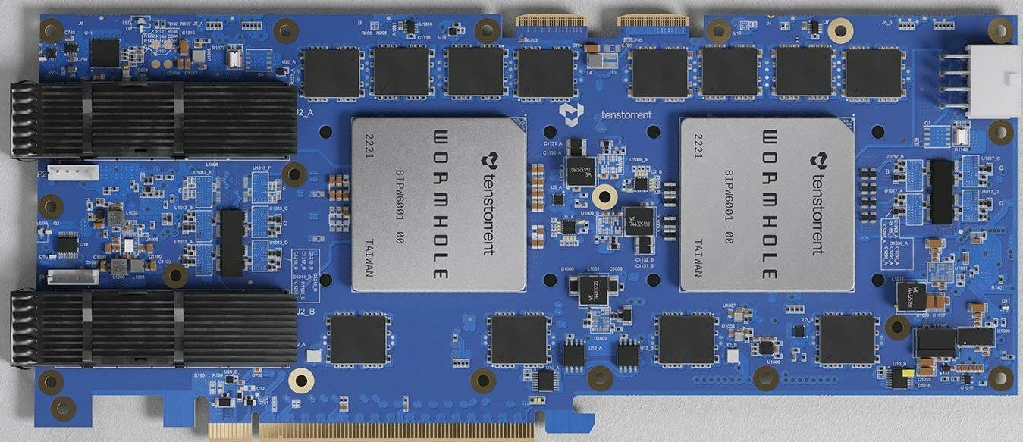


An overview of the Tenstorrent architecture

Slide 2
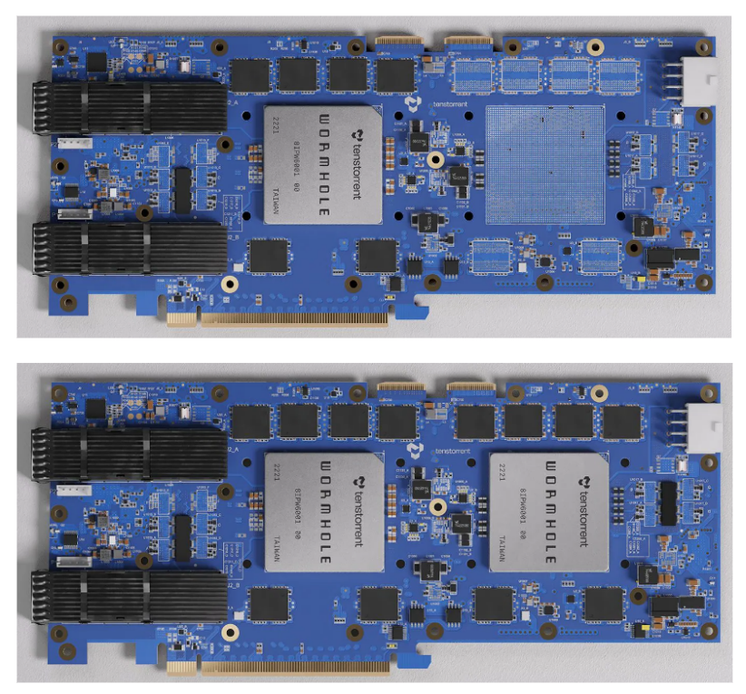
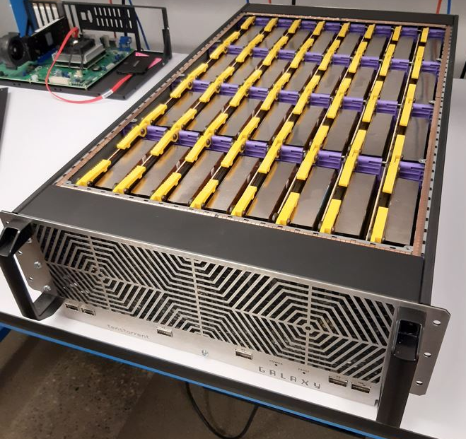
Scaling out rather than up
The Tenstorrent approach is to scale out a (fairly) simple initial compute unit across a chip and multiple chips
This simple unit is known as a Tensix unit (more on this soon….)
PCIe accelerator cards contain one or more chips, each with many Tensix units
Cards then scale by being interconnected together
These then all appear as a very large (virtual) chip
Can do this yourself with the correct cables and connectors
The Galaxy contains 32 Wormholes

Slide 3
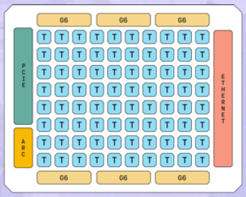
A single Wormhole chip….
Tensix unit (up to 80 on a single chip)
16x100 Gbps Ethernet
Built on a 12 nm process
12GB GDDR6 on the board
Draws up to 300 Watts
Performance:
292 TFLOPS (FP8)
164 TFLOPS (BLOCKFP8)
16 lanes of PCIe Gen 4
Chip management
Six channels of GDDR6

Slide 4
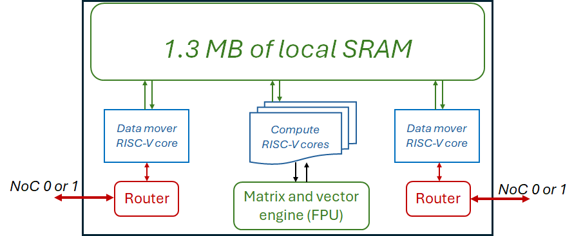
A Tensix unit
Each Tensix unit contains:
Five “baby” RISC-V CPU cores
Two of these are for data movement, three drive the compute side by driving the matrix and vector engine
A matrix and vector engine (FPU)
1.3MB of local fast SRAM (a bit like a cache)
Two routers (one connected to each data mover core)

Slide 5
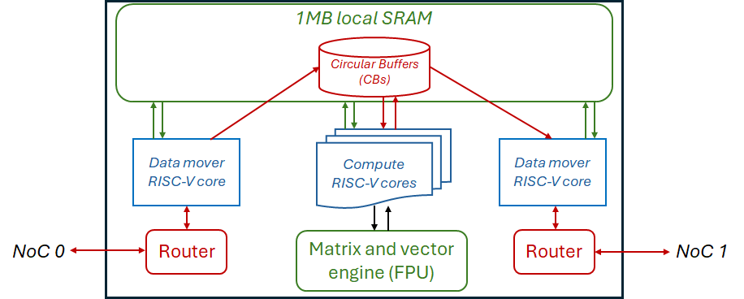
RISC-V CPU cores
The five “baby” CPU cores are very simple (32-bit RISC-V with Integer support)
Two data movers one to get data from external DDR (or another Tensix unit) in, and one to write results to DDR or another Tensix
Three compute cores that interact with the FPU
One packs data into registers of the FPU, one controls the FPU compute, and the third unpacks from FPU result registers to SRAM.
RISC-V cores communicate with each other via Circular Buffers (CBs)
CBs contain pages of memory, each is a configurable size and follows a producer-consumer approach.
Producers will wait until there is a free page, fill this and push to make it available
Consumers will block for a page to pushed and made available, read the data and then pop it

Slide 6
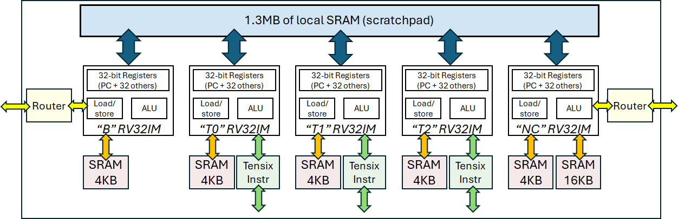
The RISC-V cores in more detail….
Each core has some associated SRAM as a local memory for data (and instructions for NC)
More details on the Tensix instructions and the compute later on….

Slide 7

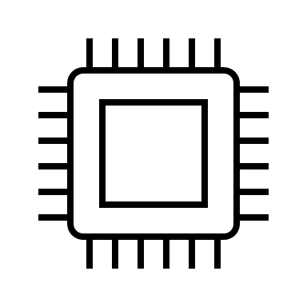
Programmer’s perspective
Host
PCIe accelerator
Input data to DDR
CB configuration
Kernels
Wormhole
Results from DDR

Slide 8
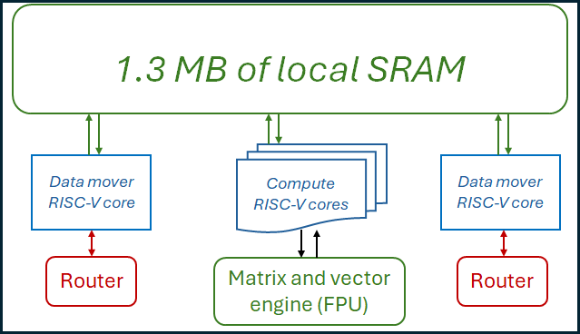
Programmer’s perspective
Host code is written by the programmer
Three kernels are written by the programmer:
Data movement in core
Compute cores
Data movement out core
Kernel
Kernel
Kernel
As we will discuss later, these can be replicated across Tensix units or individual kernels allocated on a unit by unit basis
In the host code, each kernels path and name is provided
When the host code is launched then each kernel is first compiled and launched

Slide 9
TT-Metalium SDK
Models
PyTorch
ONYX
Models
Tools
TT-Forge
ML graph compiler
https://github.com/tenstorrent/tt-forge-fe
Manually optimised Models
TT-MLIR
Compiler support for Tensix
https://github.com/tenstorrent/tt-mlir
TT-NN
Optimised ML building block operations
https://github.com/tenstorrent/tt-metal
Our focus today
TT-Metalium
Direct programming SDK
https://github.com/tenstorrent/tt-metal
TT-LLK
(Low level kernels)
Low level interaction with hardware
https://github.com/tenstorrent/tt-llk

